Slide 1

Fast Fourier Transform
 | TOPIC
1 | Radix-2 Cooley & Tuckey’s DIT-FFT Algorithm,
3 | DIT-FFT Flowgraph for N=4 & 8,
3 | Comparison of Complex and Real, Multiplication and Additions of DFT and FFT
4 | Inverse FFT algorithm
‹#›
Dr. Kiran TALELE 99870 30 881 kiran.talele@spit.ac.in
‹#›

Slide 2
Dr. Kiran TALELE
@ Bharatiya Vidya Bhavans’ Sardar Patel Institute of Technology Andheri(w) Mumbai
Associate Professor, Electronics Engineering Department (1997)
Dean, Students, Alumni & External Relations (2022)
@ Sardar Patel Technology Business Incubator(SP-TBI),
Funded by Department of Science & Technology(DST),
Govt. of India
Co-ordinator (2015)
@ IEEE Bombay Section
Treasurer (2020)
Executive Committee Member (2015)
Kiran TALELE
‹#›

Slide 3
Chapter-2B : Fast Fourier Transform
Objective : To illustrate FFT calculations mathematically
Outcomes :
At the end of module, students will be able to ,
Develop FFT flow-graph
Compare DFT and FFT computationally
Perform forward and Inverse FFT
Plot signal spectrum in frequency domain
Dr. Kiran TALELE 99870 30 881 kiran.talele@spit.ac.in
‹#›

Slide 4
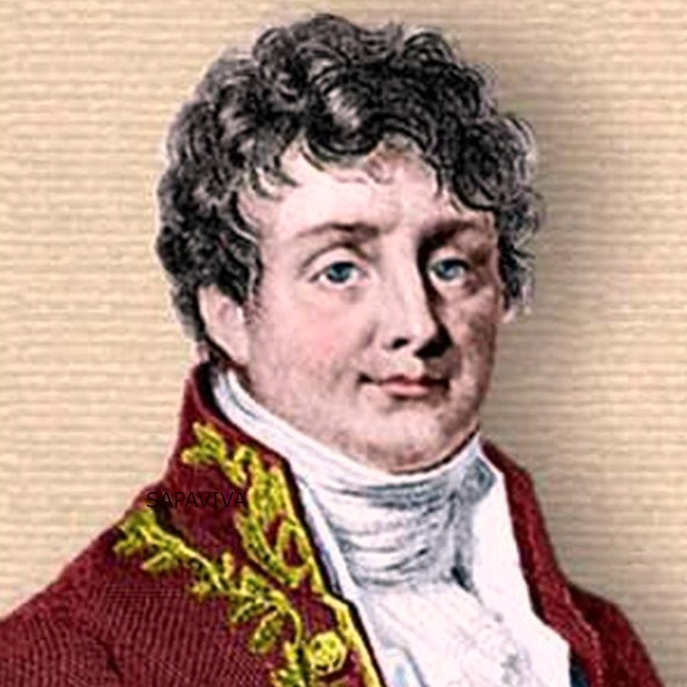
Jean Joseph Fourier
Jean-Baptiste Joseph Fourier was a French mathematician and physicist born in Auxerre and best known for initiating the investigation of Fourier series, which eventually developed into Fourier analysis and harmonic analysis, and their applications to problems of heat transfer and vibrations.
(1768-1830)
Dr. Kiran TALELE 99870 30 881 kiran.talele@spit.ac.in
‹#›
Notes:
He announced these results in a prize paper on the theory of heat.
The judges: Laplace, Lagrange and Legendre
Three of the judges found it incredible that sum of sines and cosines could add up to anything but an infinitely differential function, but...
Lagrange: Lack of mathematical rigor and generality
Denied publication….
After 15 years, following several attempts and disappointments and frustration, he published his results in Theorie Analytique de la Chaleur in 1822 (Analytical Theory of Heat).
In 1829, Dirichlet proved Fourier’s claim with very few and non-restricting conditions.
Next 150 years: His ideas expanded and generalized. 1965: Cooley and Tukey--> Fast Fourier Transform==> Computational simplicity==>King of all transforms…Many applications engineering, finance, etc.

Slide 5


F F T
Kiran TALELE
 99870 30 881

Slide 6
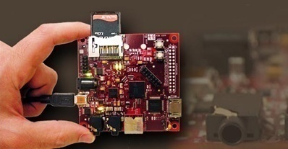
DIT FFT flowgraph for N = 4 & 8

Slide 7
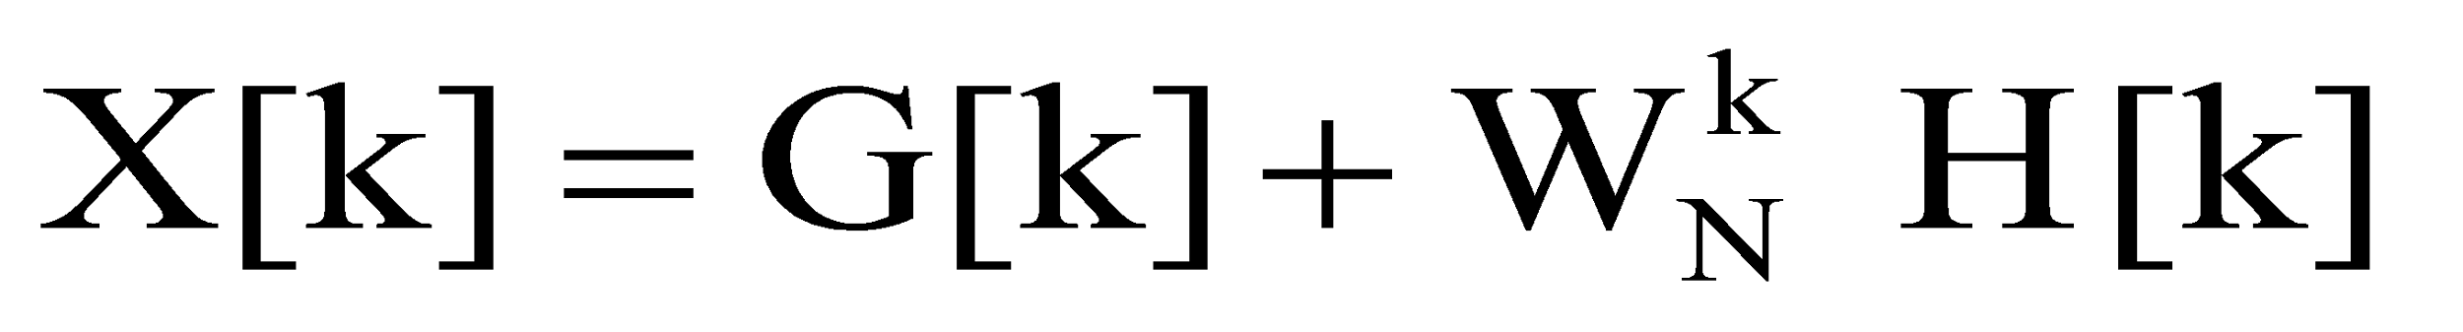

DIT FFT flowgraph for N = 4
Step-1 : Derive DIT-FFT equation
--------------
--------------
--------------
N pt pt pt
Step-2 : Derive DIT-FFT flowgraph
Dr. Kiran TALELE 99870 30 881 kiran.talele@spit.ac.in
‹#›

Slide 8
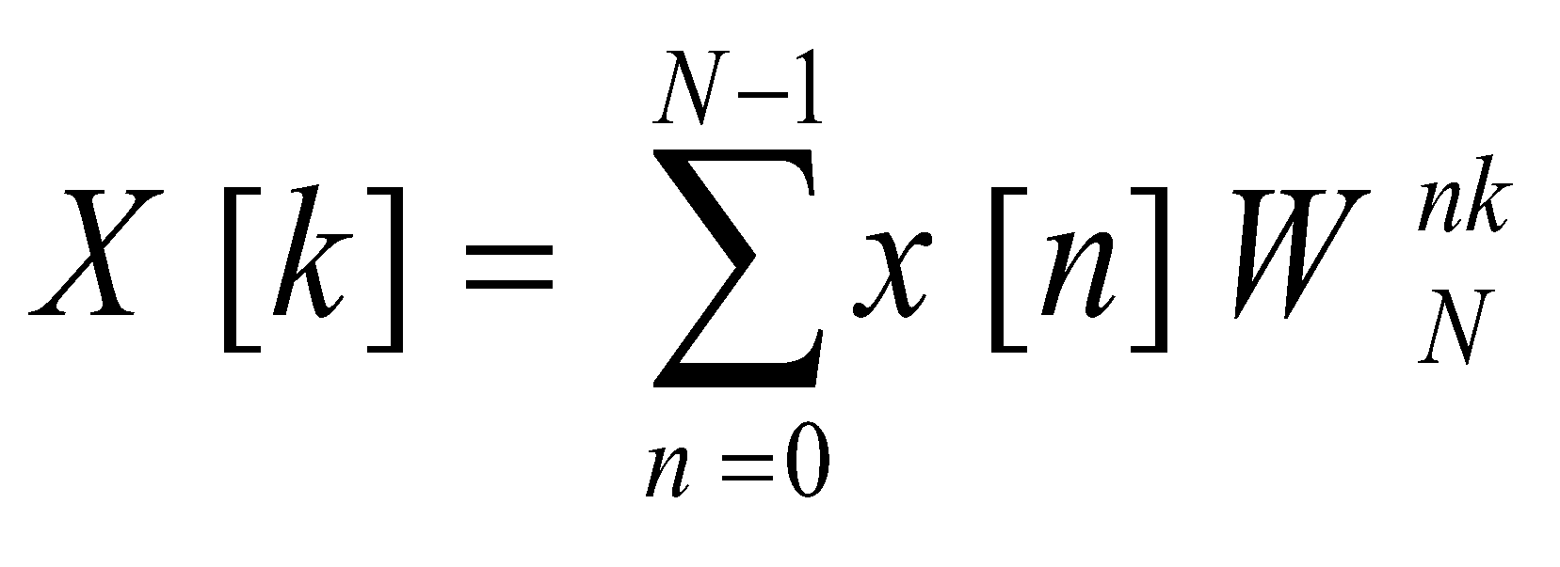
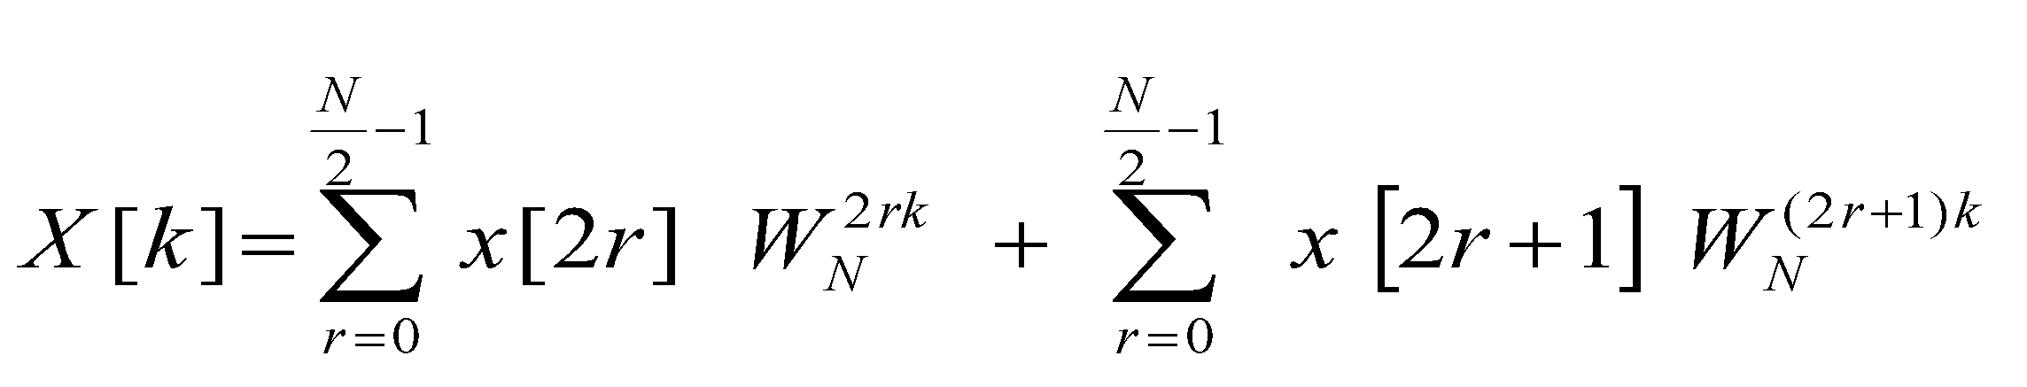
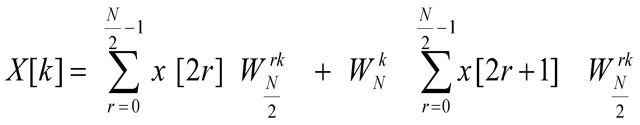

DIT FFT flowgraph for N = 4
Step-1 : Derive DIT-FFT equation
By DFT,
N pt pt pt

Slide 9




Step-2 : Derive DIT-FFT flowgraph
2 pt DFT
G[k]
G[0]
G[1]
X[0]
X[1]
X[2]
X[3]
x[0]
x[2]
–1
x[1]
X[3]
2 pt DFT H[k]
H[0]
H[1]
–1
4 pt 2 pt 2 pt

Slide 10
G[0]
G[1]
X[0]
X[1]
X[2]
X[3]
x[0]
X[2]
1
–1
-j
x[1]
X[3]
H[0]
H[1]
-1
–1
j
Kiran TALELE 99870 30 881 kiran.talele@spit.ac.in
‹#›

Slide 11
G[0]
G[1]
X[0]
X[1]
X[2]
X[3]
x[0]
X[2]
1
–1
-j
x[1]
X[3]
H[0]
H[1]
-1
–1
-1
j
DIT-FFT Flowgraph for N = 4

Slide 12
Ex-1 : Given x[n] = { 1, 2, 3, 4 }. Find X[k] using DITFFT
1
(1)+(3)= 4
X[0]
X[1]
X[2]
X[3]
x[0]
X[2]
G[0]
G[1]
3
(1)+(-3)= -2
–1
–1
x[1]
X[3]
2
(2)+(4)= 6
H[0]
H[1]
–1
-1
4
(2)+(-4)= -2
–1
–1
-1
–1

Slide 13
Ex-1 : Given x[n] = { 1, 2, 3, 4 }. Find X[k] using DITFFT
1
4
4
4
10
X[0]
X[1]
X[2]
X[3]
x[0]
X[2]
3
-2
-2
-2+2j
–1
2
6
6
x[1]
X[3]
6
-2
–1
4
-2
2j
-2-2j
–1
–1
Kiran TALELE 99870 30 881 kiran.talele@spit.ac.in
‹#›

Slide 14
Ex-2 : Given x[n] = { 1, 2, 3, 2 }. Find X[k] using DITFFT
Solution : To Find X[k] using FFT
1
4
4
4
8
X[0]
X[1]
X[2]
X[3]
x[0]
X[2]
3
-2
-2
-2
–1
x[1]
X[3]
2
4
4
0
–1
-1
2
-2
0
0
-2
–1
–1

Slide 15
DIT FFT flowgraph for N = 8
Step-1 : Derive DIT-FFT equation
--------------
--------------
--------------
N pt pt pt
Step-2 : Derive DIT-FFT flowgraph
Kiran TALELE 99870 30 881 kiran.talele@spit.ac.in
‹#›

Slide 16
Step-2 : Derive DIT-FFT flowgraph
X[0]
X[2]
X[4 ]
X[6 ]
G[0]
G[1]
G[2]
G[3]
X[0]
X[1]
X[2]
X[3]
X[4]
X[5]
X[6]
X[7]
4 pt DFT
G[k]
–1
–1
–1
–j
–1
X[1]
X[3]
X[5]
X[7]
H[0]
H[1]
H[2]
H[3]
4 pt DFT
H[k]

Slide 17





x[0]
x[2 ]
x[4]
x[6]
4 pt DFT
G[k]
G[0]
G[1]
G[2]
G[3]
X[0]
X[1]
X[2]
X[3]
X[4]
X[5]
X[6]
X[7]
–1
–1
–1
–j
–1
x[1]
x[3 ]
x[5]
x[7]
H[0]
H[1]
H[2]
H[3]
4 pt DFT
H[k]
–1
–1
–j
–1
–1
8 pt 4 pt 4 pt
‹#›

Slide 18
x[0]
x[2]
x[4]
x[6]
4 pt DFT
G[k]
G[0]
G[1]
G[2]
G[3]
X[0]
X[1]
X[2]
X[3]
X[4]
X[5]
X[6]
X[7]
–1
–1
–1
–j
–1
x[1]
x[3 ]
x[5]
x[7]
H[0]
H[1]
H[2]
H[3]
4 pt DFT
H[k]
–1
–1
–j
–1
–1
Kiran TALELE 99870 30 881 kiran.talele@spit.ac.in
‹#›

Slide 19
x[ ]
x[ ]
x[ ]
x[ ]
x[ ]
x[ ]
x[ ]
x[ ]
G[0]
G[1]
G[2]
G[3]
X[0]
X[1]
X[2]
X[3]
X[4]
X[5]
X[6]
X[7]
x[ 0 ]
x[ 4 ]
x[ 2 ]
x[ 6 ]
x[ ]
x[ ]
x[ ]
x[ ]
–1
–1
–1
–1
H[0]
H[1]
H[2]
H[3]
–1
–1
–1
–1
Kiran TALELE 99870 30 881 kiran.talele@spit.ac.in
‹#›

Slide 20
x[ ]
x[ ]
x[ ]
x[ ]
x[ ]
x[ ]
x[ ]
x[ ]
G[0]
G[1]
G[2]
G[3]
X[0]
X[1]
X[2]
X[3]
X[4]
X[5]
X[6]
X[7]
x[0]
x[4]
x[2]
x[6]
x[1]
x[5]
x[3]
x[7]
–1
–1
–1
–1
H[0]
H[1]
H[2]
H[3]
–1
–1
–1
–1
Kiran TALELE 99870 30 881 kiran.talele@spit.ac.in
‹#›

Slide 21
X[0]
X[1]
X[2]
X[3]
X[4]
X[5]
X[6]
X[7]
x[0]
x[4]
x[2]
x[6]
[[
x[1]
x[5]
x[3]
x[7]
G[0]
G[1]
G[2]
G[3]
H[0]
H[1]
H[2]
H[3]
–1
–1
–1
–1
–1
–1
–1
–1
–1
–1
–1
–1
DIT-FFT Flowgraph for N = 8

Slide 22
Ex-1 : Given x[n] = { 1, 2, 3, 4, 5, 6, 7, 8 }.
Find X[k] using DIT-FFT.
Solution : To Find X[k] using DIT-FFT
Kiran TALELE 99870 30 881 kiran.talele@spit.ac.in
‹#›

Slide 23
Given x[n] = { 1, 2, 3, 4, 5, 6, 7, 8 }
1
6
( 16 )
X[0]
X[1]
X[2]
X[3]
X[4]
X[5]
X[6]
X[7]
x[0]
x[4]
x[2]
x[6]
[[
x[1]
x[5]
x[3]
x[7]
(-4+ 4j)
5
-4
–1
10
( - 4 )
3
–1
(-4- 4j)
7
4j
–1
–1
( 20 )
2
8
–1
(-4+ 4j)
6
-4
–1
–1
4
( - 4 )
12
–1
(-4- 4j)
–1
8
4j
–1
–j
–1
–1
Kiran TALELE 99870 30 881 kiran.talele@spit.ac.in
‹#›

Slide 24
Find X[k] :
X[0] =
= ( 16 ) + ( 20 )
X(0) = 36
(2) X[1] =
= ( -4+4j ) + ( -4+4j )
= ( -4+4j ) + ( -4+4j ) ( 0.707 –j 0.707 )
X(1) = – 4 + j 9.656
(3) X[2] =
= ( -4 ) + ( -4 )
= ( -4 ) + ( -4 ) ( - j )
X(2) = - 4 + 4 j
(4) X[3] =
= ( -4-4j ) + ( -4-4j )
= ( -4-4j ) + ( -4-4j ) ( -0.707 –j 0.707 )
X[3] = – 4 + j 1.656

Slide 25
(5) X[4] =
= ( 16 ) - ( 20 )
X[4] = - 4
(6) X[5] =
= ( -4-4j ) – ( -4-4j )
= ( -4-4j ) – ( -4-4j ) [ 0.707 –j 0.707]
X[5] = – 4 - j 1.656
(7) X[6] =
= ( -4 ) - ( -4 )
= ( -4 ) - ( -4 ) [ -j ]
X[6] = – 4 – 4 j
Kiran TALELE 99870 30 881 kiran.talele@spit.ac.in
‹#›

Slide 26

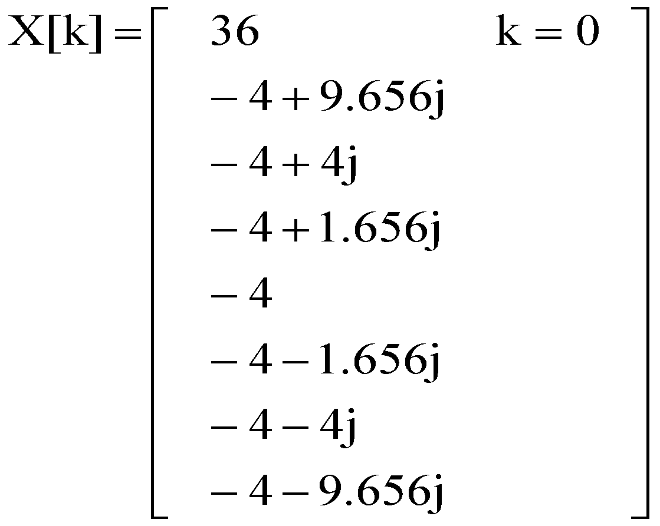
ANS :
(8) X[7] =
= ( -4-4j ) – ( -4-4j )
X[7] =
= ( -4-4j ) – ( -4-4j ) [-0.707-j 0.707]
X[7] = – 4 – j 9.656
Kiran TALELE 99870 30 881 kiran.talele@spit.ac.in
‹#›

Slide 27
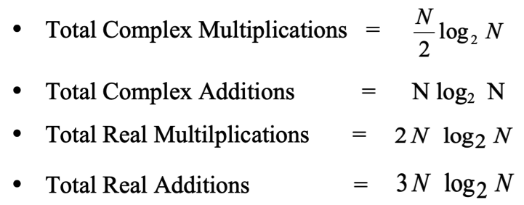
Computational Efficiency of FFT
Kiran TALELE 99870 30 881 kiran.talele@spit.ac.in
‹#›

Slide 28
Computational Efficiency of FFT
Kiran TALELE 99870 30 881 kiran.talele@spit.ac.in
‹#›

Slide 29
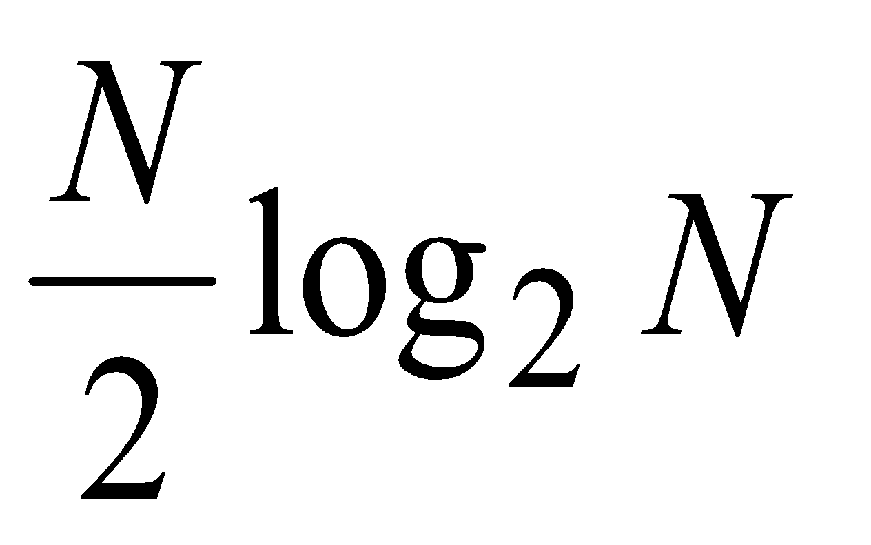
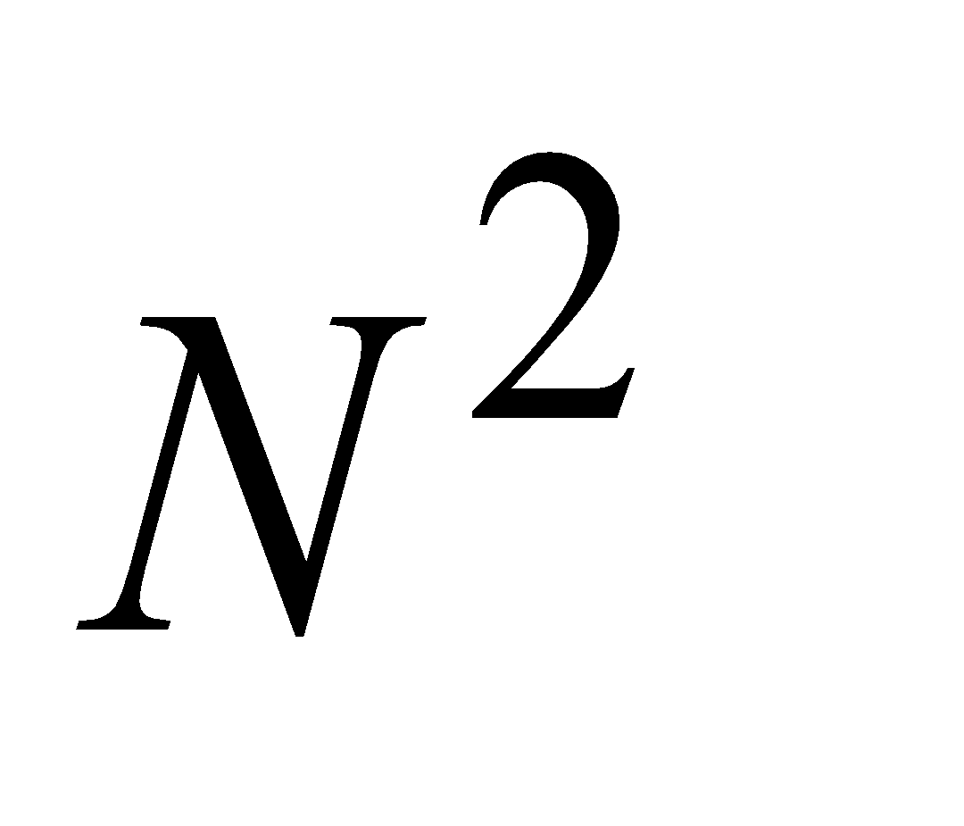
Computational Efficiency of FFT
 | DFT | FFT | Speed Factor
N
8 | 64 | 12 | 5.3
16 | 256 | 32 | 8.0
32 | 1,024 | 80 | 12.8
64 | 4,096 | 192 | 21.3
256 | 65,536 | 1,024 | 64.0
512 | 2,62,144 | 2,304 | 113.77
1024 | 10,48,576 | 5,120 | 204.8
Kiran TALELE 99870 30 881 kiran.talele@spit.ac.in
‹#›

Slide 30
X [ 0 ]
X[ 4 ]
X[ 2 ]
X[ 6 ]
X[ ]
X[ ]
X[ ]
X[ ]
X [ 0 ]
X[ 4 ]
X[ 2 ]
X[ 6 ]
X[ 1 ]
X[ 5 ]
X[ 3 ]
X[ 7 ]
X[000]
X [ 0 ]
X[ 4 ]
X[ ]
X[ ]
X[ ]
X[ ]
X[ ]
X[ ]
X[0]
X[1]
X[2]
X[3]
X[4]
X[5]
X[6]
X[7]
X [ ]
X[ ]
X[ ]
X[ ]
X[ ]
X[ ]
X[ ]
X[ ]
X [ 0 ]
X[ ]
X[ ]
X[ ]
X[ ]
X[ ]
X[ ]
X[ ]
DIT-FFT
Flowgraph
for N=8
X[000]
X[100]
X[001]
X[010]
X[010]
X[110]
X[011]
X[001]
X[100]
X[101]
X[101]
X[011]
X[110]
X[111]
X[111]

Slide 31
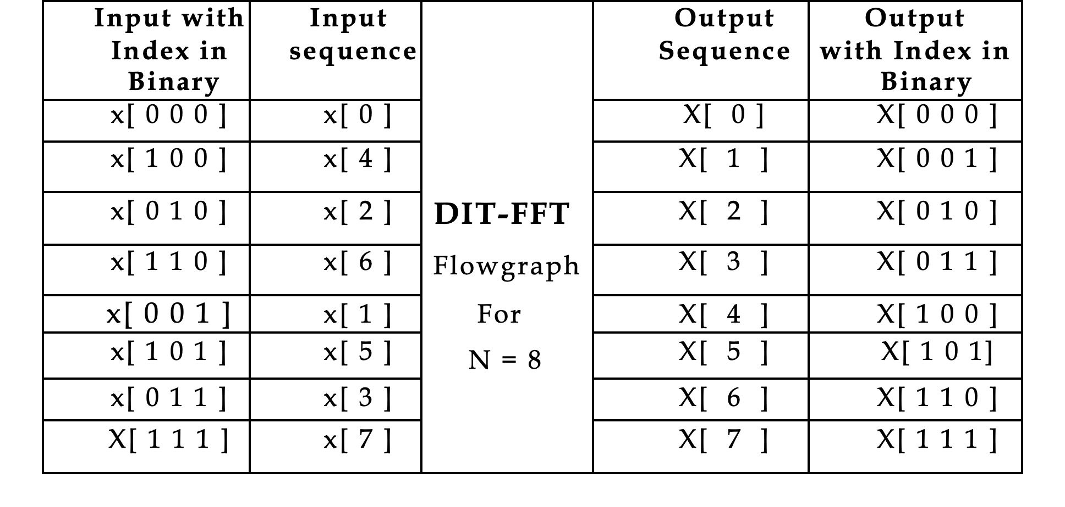
Bit Reversal Technique :
Kiran TALELE 99870 30 881 kiran.talele@spit.ac.in
‹#›

Slide 32

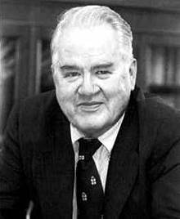
James John
James COOLEY John TUKEY
Kiran TALELE 99870 30 881 kiran.talele@spit.ac.in
‹#›

Slide 33
In 1965, James W. Cooley and John W. Tukey (IEEE 1982 Medal of Honor recipient) published a paper describing the Fast Fourier Transform (FFT) algorithm, which led to an explosion in Digital Signal Processing.
James COOLEY
Their landmark research offered enormous improvements in processing speeds and played an essential role in the digital revolution.
John TUKEY
Kiran TALELE 99870 30 881 kiran.talele@spit.ac.in
‹#›

Slide 34
Inverse FFT Algorithm
Using Forward FFT Flowgraph
Using Inverse FFT Flowgraph
Kiran TALELE 99870 30 881 kiran.talele@spit.ac.in
‹#›

Slide 35
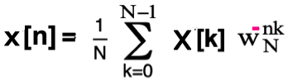
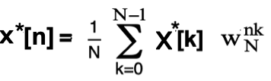
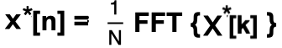
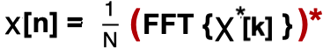
Inverse FFT using Forward FFT Flowgraph
By Complex Conjugate on Both Sides,
IFFT ALGORITHM
Find X*[k]
Find FFT ( X*[k] )
Find x[n] using IFFT equation
By Complex Conjugate on Both Sides,
This is an
IFFT equation

Slide 36

X[k] =
66 k=0
Ex-1. Given
-22+2j
-2
-22-2j
Find x[n] using Forward FFT.
Solution : To find x[n]
By IFFT equation:
x[n] =
Kiran TALELE 99870 30 881 kiran.talele@spit.ac.in
‹#›

Slide 37
IFFT ALGORITHM
Find X*[k]
Find FFT ( X*[k] )
Find x[n] using IFFT equation
Find X*[k]
X[k] =
66 k=0
Now,
-22 + 2j
-2
-22 - 2j
X*[k] =
66 k=0
-22 - 2j
-2
-22 + 2j
Kiran TALELE 99870 30 881 kiran.talele@spit.ac.in
‹#›

Slide 38
II. Find FFT ( X*[k] )
X*[0]
X*[2]
X*[1]
X*[3]
66
64
64
20
x*[0]
x*[1]
x*[2]
x*[3]
-2
68
68
64
–1
-44
-22-2j
-44
6
108
-1
-22+2j
-4j
-4
72
–1
-1
Kiran TALELE 99870 30 881 kiran.talele@spit.ac.in
‹#›

Slide 39
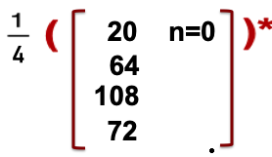
III. Find x[n]
x[n] =
By IFFT :
x[n] =
x[n] =
5 n=0
16
27
18
Kiran TALELE 99870 30 881 kiran.talele@spit.ac.in
‹#›

Slide 40
X[k] =
66 k=0
Ex-2. Given
-22+2j
-2
-22-2j
Find x[n] using Inverse FFT.
Kiran TALELE 99870 30 881 kiran.talele@spit.ac.in
‹#›

Slide 41
To Find x[n] using Inverse FFT
X[0]
X[2]
X[1]
X[3]
20
x’[0]
x’[1]
x’[2]
x’[3]
66
64
64
-2
68
68
64
–1
-44
-22+2j
-44
6
108
-1
-22-2j
4j
-4
72
–1
-1
Kiran TALELE 99870 30 881 kiran.talele@spit.ac.in
‹#›

Slide 42
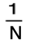
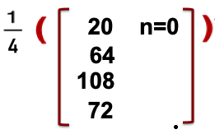
Find x[n]
x[n] =
x’[n]
By IFFT :
x[n] =
x[n] =
5 n=0
16
27
18
Kiran TALELE 99870 30 881 kiran.talele@spit.ac.in
‹#›

Slide 43
Ex : Let x[n] = {1, 2, 3, 4} (a) Find X[k] using DIT-FFT. (b) Let p[n] = { 1, 0, 2, 0, 3, 0, 4, 0 }. Find P[k] using X[k].
Solution : (a) To finds X[k] using DITFFT
Kiran TALELE 99870 30 881 kiran.talele@spit.ac.in
‹#›

Slide 44
Given x[n] = { 1, 2, 3, 4 }.
1
4
4
4
10
X[0]
X[1]
X[2]
X[3]
x[0]
X[2]
3
-2
-2
-2+2j
–1
–1
2
6
6
x[1]
X[3]
6
-2
–1
4
-2
2j
-2-2j
–j
–1
–1
Kiran TALELE 99870 30 881 kiran.talele@spit.ac.in
‹#›

Slide 45
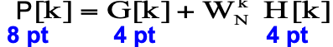
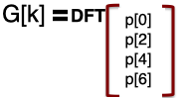
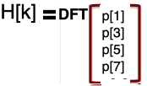
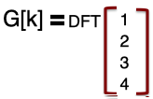
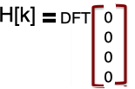
(b) Let p[n] = { 1, 0, 2, 0, 3, 0, 4, 0 }. Find P[k] using X[k].
To find P[k]
Let
---Eqn (1)
Where G[k] = DFT{ p(2r) } and H[k] = DFT { p(2r+1 ) }
G[k] = X[k]
H[k] = 0
‹#›

Slide 46
By Substituting G[k] = X[k] and H[k] = 0 in Eqn (1) we get,
P[k] = X[k]
------------------------
P[0] = X[0] = = 10
P[1] = X[1] = = -2+2J
P[2] = X[2] = = -2
P[3] = X[3] = = -2-2J
P[4] = X[4] = = 10
P[5] = X[5] = = -2+2J
P[6] = X[6] = = -2
P[7] = X[7] = = -2-2J
Kiran TALELE 99870 30 881 kiran.talele@spit.ac.in
‹#›

Slide 47
Convolution using FFT

Slide 48
Ex-1 Let x[n] = [ 1, 2, 3, 4 } and h[n] = { 5, 6, 7 }
Find Circular Convolution using FFT
Solution :
Here x[n] is L=4 point and h[n] is M = 3 point
Select N
N = Max (L,M)
N = Max (4,3) == 4
II. Zero Padding
x[n] = [ 1, 2, 3, 4 }
h[n] = { 5, 6, 7, 0 }
Kiran TALELE 99870 30 881 kiran.talele@spit.ac.in
‹#›

Slide 49
III. Find y[n] = x[n] ⊗ h[n] using FFT
X[k]
x[n]
N pt
FFT
Y[k]
y[n]
IFFT
h[n]
N pt
FFT
H[k]
Kiran TALELE 99870 30 881 kiran.talele@spit.ac.in
‹#›

Slide 50
(1). Find X[k] using DIT-FFT
1
4
4
10
4
X[0]
X[1]
X[2]
X[3]
x[0]
X[2]
3
-2
-2
-2+2j
–1
2
6
6
-2
x[1]
X[3]
6
–1
4
-2
2j
-2-2j
–j
–1
–1
Kiran TALELE 99870 30 881 kiran.talele@spit.ac.in
‹#›

Slide 51
(2). Find H[k] using DIT-FFT
5
12
12
18
4
H[0]
H[1]
H[2]
H[3]
h[0]
h[2]
7
-2
-2
-2-6j
–1
6
6
6
6
h[1]
h[3]
6
–1
0
6
-6j
-2+6j
–j
–1
–1
Kiran TALELE 99870 30 881 kiran.talele@spit.ac.in
‹#›

Slide 52
III. Find y[n] By Inverse FFT
Y[0]
Y[2]
Y[1]
Y[3]
180
168
168
200
y’[0]
y’[1]
Y’[2]
Y’[3]
-12
192
192
176
–1
32
32
6
136
16+8j
-1
16-8j
16 j
-16
208
–1
-1
Kiran TALELE 99870 30 881 kiran.talele@spit.ac.in
‹#›

Slide 53
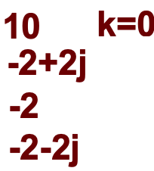
(3). Find Y[k]
Y[k] = X[k] H[k]
Y[k] =
18 k=0
-2-6j
6
-2+6j
Y[k] =
180 k=0
16+8j
-12
16-8j
Kiran TALELE 99870 30 881 kiran.talele@spit.ac.in
‹#›

Slide 54

To verify :
Now y[n] = y’[n]
x[n] = [ 1, 2, 3, 4 }
h[n] = { 5, 6, 7, 0 }
y[n] =
200 n=0
y[n] =
5 0 7 6
1
176
6 5 0 7
2
136
7 6 5 0
3
208
0 7 6 5
4
y[n] =
y[n] =
50 n=0
50
44
44
34
34
52
52
Kiran TALELE 99870 30 881 kiran.talele@spit.ac.in
‹#›

Slide 55
Ex-1 Let x[n] = [ 1, 2, 3 } and h[n] = { 5, 6 }
Find Linear Convolution using FFT
Solution :
Here x[n] is L= 3 point and h[n] is M = 2 point
Select N
N ≥ L+M-1
N ≥ 3+2-1 == 4
II. Zero Padding
x[n] = [ 1, 2, 3, 0 }
h[n] = { 5, 6, 0, 0 }
Kiran TALELE 99870 30 881 kiran.talele@spit.ac.in
‹#›

Slide 56
III. Find y[n] = x[n] ⊗ h[n] using FFT
X[k]
x[n]
N pt
FFT
Y[k]
y[n]
IFFT
h[n]
N pt
FFT
H[k]
Kiran TALELE 99870 30 881 kiran.talele@spit.ac.in
‹#›

Slide 57
(1). Find X[k] using DIT-FFT
1
4
4
6
X[0]
X[1]
X[2]
X[3]
4
x[0]
x[2]
3
-2
-2
-2-2J
–1
2
2
6
2
x[1]
X[3]
2
–1
0
2
-2J
-2+2J
–j
–1
–1

Slide 58
(2). Find H[k] using DIT-FFT
5
5
5
11
H[0]
H[1]
H[2]
H[3]
4
h[0]
h[2]
0
5
5
5-6J
–1
6
6
6
-1
h[1]
h[3]
6
–1
0
6
-6J
5+6J
–j
–1
–1
Kiran TALELE 99870 30 881 kiran.talele@spit.ac.in
‹#›

Slide 59
(3). Find Y[k]
Y[k] = X[k] H[k]
Y[k] =
6 k=0
11 k=0
-2-2j
5-6j
2
-1
-2+2j
5+6j
Y[k] =
66 k=0
-22+2j
-2
-22-2j
Kiran TALELE 99870 30 881 kiran.talele@spit.ac.in
‹#›

Slide 60
III. Find y[n] using Inverse FFT
Y[0]
Y[2]
Y[1]
Y[3]
20
y’[0]
y’[1]
y’[2]
y’[3]
66
64
64
-2
68
68
64
–1
-44
-22+2j
-44
6
108
-1
-22-2j
4j
-4
72
–1
-1
Kiran TALELE 99870 30 881 kiran.talele@spit.ac.in
‹#›

Slide 61
Now y[n] = y’[n]
To verify :
y[n] =
20 n=0
x[n] |  | 1 | 2 | 3 | y[n]
h[-n] | 6 | 5
x[n] |  | 1 | 2 | 3 | y[n]
h[-n] | 6 | 5
 |  | 6 | 5
 |  |  | 6 | 5
 |  |  |  | 6
x[n] |  | 1 | 2 | 3
h[-n] | 6 | 5 |  |  | 5
 |  | 6 | 5 |  | 16
 |  |  | 6 | 5 | 27
 |  |  |  | 6 | 18
64
108
72
y[n] =
5 n=0
16
27
18
Kiran TALELE 99870 30 881 kiran.talele@spit.ac.in
‹#›

Slide 62
APPLICATIONS FFT (i) Linear Filtering (ii) Spectral Analysis

Slide 63
APLICATIONS OF D F T / F F T
(i) Linear Filtering : To find output of a
digital FIR filter for any given input say x[n].
(ii) Spectral Analysis : To find magnitude
spectrum and phase spectrum of signal.
Kiran TALELE 99870 30 881 kiran.talele@spit.ac.in
‹#›

Slide 64
Linear Filtering : To find output of a
digital FIR filter for any given input say x[n]
x[n]
Digital FIR Filter h[n]
y[n]=x[n]* h[n]
LC by LC Formula Method
LC by CC Formula Method
LC by DFT Formula Method
LC by FFT Algorithm
None of above mehod is suitable for Real Time Application

Slide 65
Limitations of LC by FFT Algorithms
Algorithm is NOT suitable for Real Time Applications where entire input signal is not available.
Examples include
(i) ECG Monitoring system
Digital Telephone System
(iii) Weather Monitoring System
Kiran TALELE 99870 30 881 kiran.talele@spit.ac.in
‹#›

Slide 66
Limitations of LC by FFT Algorithms...
(2) Algorithm is NOT suitable for Long Data Sequence.
Examples include
Digital Song in the form of wave file (Fs = 44.1 KHz)
ECG/Weather Monitoring Systems.
In most of the real Time applications data is Long sequence.
If N is too large as for long data sequences,
then there is a significant delay in processing, that will make processing, almost impossible for real-time applications
Kiran TALELE 99870 30 881 kiran.talele@spit.ac.in
‹#›

Slide 67
Linear FIR filtering using FAST Algorithm
x[n]
Digital FIR Filter h[n]
y[n]=x[n]* h[n]
Overlap Add Method
Overlap Save Method
Kiran TALELE 99870 30 881 kiran.talele@spit.ac.in
‹#›

Slide 68
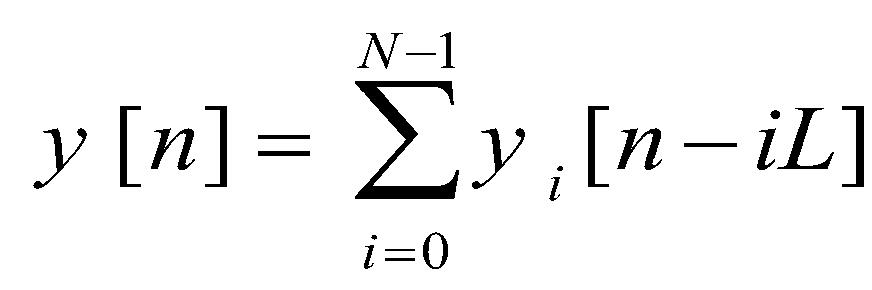
Overlap Add fast Convolution Algorithm
I. Decompose x[n] into L point sequences
II. Select N
III. Append h[n] with (N-M) zeros and find H [k] using
N pt FFT flowgraph
IV. Append each input signal data block by (N-L)
zeros and find DFT of each block using N pt FFT
algorithm
V. Let Yi [k] = Xi [k] . H [k] for i = 0,1…..
VI. Obtain y_{i}[n] by N pt iFFT Algorithm
VII. Find y[n] i.e.

Slide 69
Ex. Given
h[n] = δ[n] + 2 δ[n-1] + 3 δ[n-2] + 4 δ[n-3]
Find the response of the filter to the
input x[n]={ 2, 0, 2, 0, 2, 1, 0, 2, 1 }
using Overlap Add Method.
Solution : To Output of the filter i.e. y[n]
Given , h[n] = δ[n] + 2 δ[n-1] + 3 δ[n-2] + 4 δ[n-3]
So, h[n]= { 1, 2, 3, 4 }. Length M = 4
Kiran TALELE 99870 30 881 kiran.talele@spit.ac.in
‹#›

Slide 70
Given h[n]= { 1, 2, 3, 4 }. Length M = 4
and x[n] = { 2, 0, 2, 0, 2, 1, 0, 2, 1 }
------------------------------------------------------------------
Select L
Assume N = 8 for Radix 2 FFT Algorithm
Now N = L + M -1
8 = L + 4 – 1
L = 5
Kiran TALELE 99870 30 881 kiran.talele@spit.ac.in
‹#›

Slide 71
Given h[n]= { 1, 2, 3, 4 }. Length M = 4
and x[n] = { 2, 0, 2, 0, 2 , 1, 0, 2, 1 }
------------------------------------------------------------------
(II) Decompose x[n]
By decomposing x[n] into L=5, we get,
x₁[n] ={ 2, 0, 2, 0, 2 }
x₂[n] ={ 1, 0, 2, 1, }
(II) Decompose x[n]
By decomposing x[n] into L=5, we get,
x₁[n] ={ 2, 0, 2, 0, 2 }
x₂[n] ={ 1, 0, 2, 1, 0
Kiran TALELE 99870 30 881 kiran.talele@spit.ac.in
‹#›

Slide 72
(III) Zero Padding
x₁[n] = { 2, 0, 2, 0, 2, 0, 0, 0 } N=8 pt
x₂[n] = { 1, 0, 2, 1, 0, 0, 0, 0 } N=8 pt
h[n] = { 1, 2, 3, 4, 0, 0, 0, 0 } N=8 pt
h[-n] = { 1, 0, 0, 0, 0, 4, 3, 2 }
Kiran TALELE 99870 30 881 kiran.talele@spit.ac.in
‹#›

Slide 73
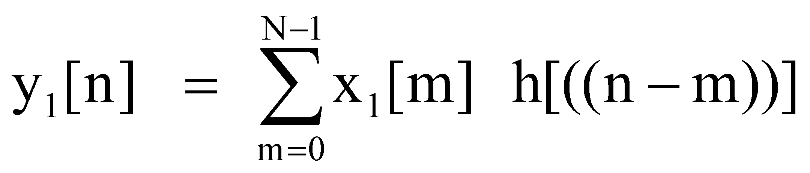


(IV) Find y₁[n]
y₁[n] =
==
1 0 0 0 0 4 3 2
2
0
2
0
2
0
0
0
2
4
8
12
8
12
6
8
2 1 0 0 0 0 4 3
3 2 1 0 0 0 0 4
4 3 2 1 0 0 0 0
0 4 3 2 1 0 0 0
0 0 4 3 2 1 0 0
0 0 0 4 3 2 1 0
0 0 0 0 4 3 2 1
Kiran TALELE 99870 30 881 kiran.talele@spit.ac.in
‹#›

Slide 74
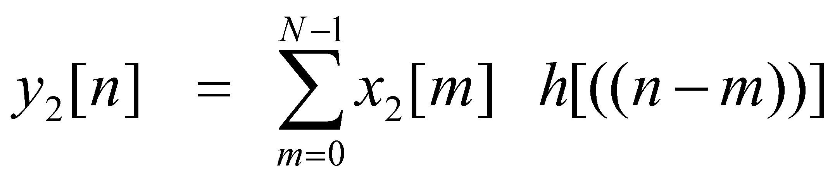
(V) Find y₂[n]
y₂[n] =
==
1 0 0 0 0 4 3 2
1
0
2
1
0
0
0
0
1
2
5
9
8
11
4
0
2 1 0 0 0 0 4 3
3 2 1 0 0 0 0 4
4 3 2 1 0 0 0 0
0 4 3 2 1 0 0 0
0 0 4 3 2 1 0 0
0 0 0 4 3 2 1 0
0 0 0 0 4 3 2 1
Kiran TALELE 99870 30 881 kiran.talele@spit.ac.in
‹#›

Slide 75

(VI) Find y[n]
Now y[n] = y₁[n] + y₂[n-L]
Put L = 5
y[n] = y₁[n] + y₂[n-5]
To find y[n] :
y₁[n] =
+
y₂[n-5]=
{ 2 4 8 12 8 12 6 8 }
{ 0 0 0 0 0 1 2 5 9 8 11 4 0 }
{ 1 2 5 9 8 11 4 0 }
=====================================
{ 2, 4, 8,12, 8, 13, 8, 13, 9, 8, 11, 4, 0 }
y[n] =

Slide 76
Overlap Save fast Convolution Algorithm
1. Decompose x[n] into L point sequences
2. Select N ≥ L +M + 1
3. Begin each decomposed input sequence with (N–L)
values of previous sequence
4. Append h[n] with (N–M) zeros and find H[k] using N point
FFT.
5. Perform N – point FFT on the selected data block X_{i} [n]
6. Let Yi[k] = Xi[k] . H[k]
7. Perform N point iFFT of Yi[k]
8. Discard the first ( N–L) values of y _{i} [n] and save the
remaining values of y_{i} [n]
9. y[n] is obtained by concatenating all the saved values of
y_{i}[n]
Kiran TALELE 99870 30 881 kiran.talele@spit.ac.in
‹#›

Slide 77
Ex. Given
h[n] = δ[n] + 2 δ[n-1] + 3 δ[n-2] + 4 δ[n-3]
Find the response of the filter to the
input x[n]={ 2, 0, 2, 0, 2, 1, 0, 2, 1 }
using Overlap Save Method.
Solution : To Output of the filter i.e. y[n]
Kiran TALELE 99870 30 881 kiran.talele@spit.ac.in
‹#›

Slide 78
Given h[n]= { 1, 2, 3, 4 }. Length M = 4
and x[n] = { 2, 0, 2, 0, 2, 1, 0, 2, 1 }
------------------------------------------------------------------
Select L
Assume N = 8 for Radix 2 FFT Algorithm
Now N = L + M -1
8 = L + 4 – 1
L = 5
Kiran TALELE 99870 30 881 kiran.talele@spit.ac.in
‹#›

Slide 79
Given h[n]= { 1, 2, 3, 4 }. Length M = 4
and x[n] = { 2, 0, 2, 0, 2 , 1, 0, 2, 1 }
------------------------------------------------------------------
(II) Decompose x[n]
By decomposing x[n] into L= 5, we get,
x₁[n] = { 2, 0, 2, 0, 2 }
x₂[n] = { 1, 0, 2, 1, 0 }
x₃[n] = { 0, 0, 0, 0, 0 }
Kiran TALELE 99870 30 881 kiran.talele@spit.ac.in
‹#›

Slide 80
(III) Modify input Sequence
x₁[n] = { 2, 0, 2, 0, 2 } N=8 pt
x₂[n] = { 1, 0, 2, 1, 0 } N=8 pt
x₃[n] = { 0, 0, 0, 0, 0 } N=8 pt
Kiran TALELE 99870 30 881 kiran.talele@spit.ac.in
‹#›

Slide 81
(III) Modify input Sequence
x₁[n] = { 2, 0, 2, 0, 2 } N=8 pt
x₂[n] = { 1, 0, 2, 1, 0 } N=8 pt
h[n] = { 1, 2, 3, 4, } N=8 pt
h[-n] = { 1, 0, 0, 0, 0, 4, 3, 2 }
0, 0, 0,
2, 0, 2,
2, 1, 0,
x₃[n] = { 0, 0, 0, 0, 0 } N=8 pt
0, 0, 0, 0
Kiran TALELE 99870 30 881 kiran.talele@spit.ac.in
‹#›

Slide 82
(IV) Find y₁[n]
y₁[n] =
==
1 0 0 0 0 4 3 2
0
0
0
2
0
2
0
2
12
6
8
2
4
8
12
8
2 1 0 0 0 0 4 3
3 2 1 0 0 0 0 4
4 3 2 1 0 0 0 0
0 4 3 2 1 0 0 0
0 0 4 3 2 1 0 0
0 0 0 4 3 2 1 0
0 0 0 0 4 3 2 1
Kiran TALELE 99870 30 881 kiran.talele@spit.ac.in
‹#›

Slide 83
(V) Find y₂[n]
y₂[n] =
==
1 0 0 0 0 4 3 2
2
0
2
1
0
2
1
0
13
8
8
13
8
13
9
8
2 1 0 0 0 0 4 3
3 2 1 0 0 0 0 4
4 3 2 1 0 0 0 0
0 4 3 2 1 0 0 0
0 0 4 3 2 1 0 0
0 0 0 4 3 2 1 0
0 0 0 0 4 3 2 1
Kiran TALELE 99870 30 881 kiran.talele@spit.ac.in
‹#›

Slide 84
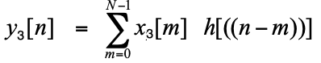
(VI) Find y₃[n]
y₃[n] =
==
1 0 0 0 0 4 3 2
2
1
0
0
0
0
0
0
2
5
8
11
4
0
0
0
2 1 0 0 0 0 4 3
3 2 1 0 0 0 0 4
4 3 2 1 0 0 0 0
0 4 3 2 1 0 0 0
0 0 4 3 2 1 0 0
0 0 0 4 3 2 1 0
0 0 0 0 4 3 2 1
Kiran TALELE 99870 30 881 kiran.talele@spit.ac.in
‹#›

Slide 85
(VII) Find y[n]
y₁[n] = { 12, 6, 8, 2, 4, 8, 12, 8 }
y₂[n] = { 13, 8, 8, 13, 8, 13, 9, 8 }
y₃[n] = { 2, 5, 8, 11, 4, 0, 0, 0 }
By discarding first (M-1) values from each output sequence we get,
=====================================
y[n] =
{ 2, 4, 8,12, 8, 13, 8, 13, 9, 8, 11, 4,0,0,0 }

Slide 86





Dr. Kiran TALELE
Academic : PhD
Professional :
Dean-Students, Alumni & External Relations @ Bharatiya Vidya Bhavans’ Sardar Patel Institute of Technology (SP-IT), Mumbai
Coordinator @ Sardar Patel Technology Business Incubator (SP-TBI), Mumbai
Treasurer-IEEE Bombay Section
091-9987030881
kiran.talele@spit.ac.in / ktvtalele@gmail.com
https://www.linkedin.com/in/k-t-v-talele/
www.facebook.com/Kiran-Talele-1711929555720263
Stay Connected
‹#›
‹#›

Slide 87
Dr. Kiran TALELE is an Associate Professor in Electronics & Telecommunication Engineering Department of Bharatiya Vidya Bhavans’ Sardar Patel Institute of Technology, Mumbai with 33+ years experience in Academics.
He is a Dean of Students, Alumni and External Relations at Sardar Patel Institute of Technology, Andheri Mumbai.
He is also a Head of Sardar Patel Technology Business Incubator, Mumbai.
His area of research is Digital Signal & Image Processing, Computer Vision, Machine Learning and Multimedia System Design.
He has published 85+ research papers at various national & international refereed conferences and journals. He has published 22 patents at Indian Patent Office. One patent is granted in 2021.
He is a Treasurer of IEEE Bombay Section and Mentor for Startup Incubation & Intellectual Asset Creation.
He received incentives for excellent performance in academics and research from Management of S.P.I.T. in 2008-09. He is a recipient of P.R. Bapat IEEE Bombay Section Outstanding Volunteer Award 2019.

Slide 88
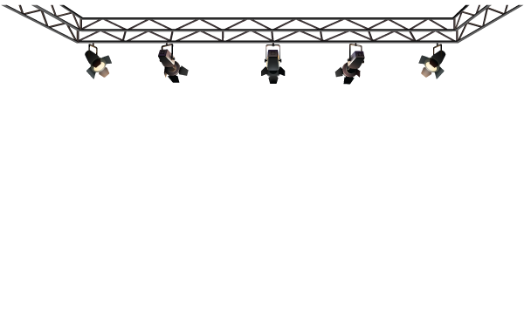



Thank you

